Slide 1
Employee Data Analysis using Excel
STUDENT NAME: HARI PRAKASH M
REGISTER NO: 312207291
NAAN MUDHALVAN ID :027BDF475BE89DAB8C54AB442CC06DBA
DEPARTMENT: B.COM(GENERAL)
COLLEGE: C KANDASWAMI NAIDU COLLEGE FOR MEN

Slide 2
PROJECT TITLE
Job Function Analysis Through Excel Data Modelling..

Slide 3


AGENDA
Problem Statement
Project Overview
End Users
Our Solution and Proposition
Dataset Description
Modelling Approach
Results and Discussion
Conclusion
3/21/2024 Annual Review

Slide 4

PROBLEM STATEMENT
The organization needs to optimize its workforce allocation across various job functions to enhance operational efficiency and meet future demand. Currently, the distribution of job functions is imbalanced, with certain roles like Technicians and Foremen being overrepresented compared to others. The goal is to model the current job function distribution to understand the workforce composition better, identify areas of overstaffing or understaffing, and predict future needs based on historical trends.

Slide 5

PROJECT OVERVIEW
This project will analyzing and evaluating employees performance across various departments such as Human resources, marketing, Acconting, services, research and development, Legal, Support, Engineering.This project includes graphs and pie chart and this project will result in a comprehensive, user-friendly excel tool that can be regularly updated and used by HR and management to drive performance improvemets within the organistion.

Slide 6

WHO ARE THE END USERS?
Employees:
Individual Employees May have access to their performance data and metrics to self-assess and identify areas for personal improvement.
Business Organization:
Business Organization and Analysts Use the data to support performance reviews, identify training needs, and develop employee development plans.Recruitment Teams Analyze data to understand the skills and performance trends that are beneficial for hiring.

Slide 7

OUR SOLUTION AND ITS VALUE PROPOSITION
Solution:*
1. *Data Analysis and Visualization*: Using descriptive analytics to understand the current job function distribution and identify areas of imbalance.
2. *Predictive Modeling*: Implementing predictive models (e.g., machine learning algorithms) to forecast future job function demands based on historical data, trends, and business needs.
3. *Optimization Algorithms*: Applying optimization techniques to recommend optimal staffing levels, ensuring that resources are allocated efficiently across all job functions.
4. *Dynamic Workforce Planning Tool*: Developing an interactive tool/dashboard that allows management to visualize current staffing levels, simulate various scenarios, and make informed decisions on hiring, training, or reallocating staff.
*Value Proposition:*
1. *Enhanced Efficiency*: By aligning staffing levels with actual operational needs, the organization can reduce overstaffing or understaffing, leading to improved productivity and cost savings.
2. *Informed Decision-Making*: The predictive models provide actionable insights, enabling management to make proactive staffing decisions based on future needs rather than reactive adjustments.
3. *Scalability*: The solution is scalable and can be adapted as the organization grows or changes, providing long-term value in workforce planning.
4. *Increased Flexibility*: The dynamic planning tool offers flexibility in adjusting staffing strategies, allowing the organization to respond quickly to market changes or unexpected demands.
5. *Strategic Resource Allocation*: By optimizing job functions, the organization can better allocate resources to high-impact areas, enhancing overall business performance and achieving strategic goals.

Slide 8
Data Description
The dataset consists of 3,000 records with 26 columns. Here is a brief description of some key columns:
1. EmpID: Unique identifier for each employee.
2. FirstName and LastName: Employee's first and last names.
3. StartDate: Date when the employee started.
4. ExitDate: Date when the employee left the company (if applicable).
5. Title: Job title of the employee.
6. Supervisor: Name of the employee's supervisor.
7. ADEmail: Company email address of the employee.
8. BusinessUnit: The business unit the employee belongs to.
9. EmployeeStatus: Indicates if the employee is active or not.
10. EmployeeType: Type of employment (e.g., full-time, part-time).
11. DepartmentType and *Division: Department and division of the employee.
12. LocationCode: Numerical code representing the employee's work location.
13. State: State where the employee is located.
14. JobFunctionDescription: A description of the employee's job function.
15. GenderCode: Gender of the employee.
16. RaceDesc: Race/ethnicity of the employee.
17. MaritalDesc: Marital status of the employee.
18. Performance Score: Employee's performance rating.
19. Current Employee Rating: Numeric rating of the employee's current performance.

Slide 9

THE "WOW" IN OUR SOLUTION
wow" features combine to create a powerful,
efficient, and intuitive Excel-based solution that
not only meets but exceeds expectations in
managing and analyzing employee
Performance. The solution includes an AI-driven feature that suggests actionable improvements based on performance trends, helping managers to implement effective strategies for boosting productivity and employee engagement. To improvement. This holistic view promotes better strategic decision-making.
3/21/2024 Annual Review
9

Slide 10
MODELLING
1. Data Preparation: Extract the job function categories and their corresponding percentages from the chart.
2. Descriptive Statistics:
- Calculate the mean, median, and mode of the job counts if raw counts are available.
- Determine the variability or spread of job function counts.
3. Distribution Modeling:
- Use a categorical distribution to model the likelihood of each job function occurring based on its percentage share.
- Apply a multinomial distribution if you're interested in modeling the counts of each category.
4. Predictive Modeling:
- Utilize classification models (e.g., decision trees, random forests) to predict the most common job functions based on features like job requirements, department, or historical data.
- Use clustering methods (like K-means) if you want to group similar job functions.
5. Visualization:
- Recreate similar visualizations (pie or bar charts) using modeling results to validate your model.
10

Slide 11
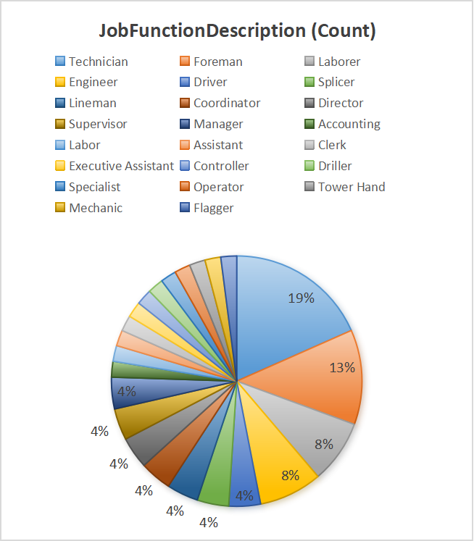
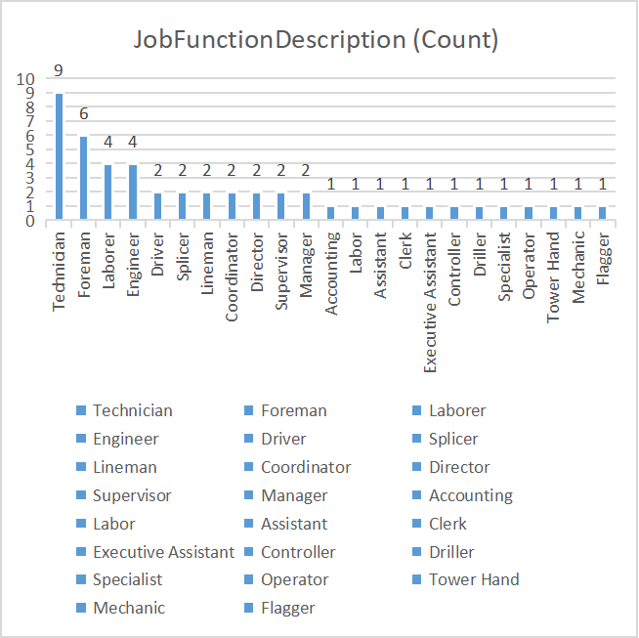
RESULTS
The two charts display the distribution of job functions with their counts.
1. *Pie Chart*: The largest category is "Technician" at 19%, followed by "Foreman" at 13%. Several other job functions are evenly distributed, each representing about 4%.
2. *Bar Chart*: It shows specific counts for each job function, with "Technician" having the highest count (9), followed by "Foreman" (6), and "Laborer" (4). The rest have counts between 1 and 2, indicating a more evenly distributed representation among the other job functions.
11

Slide 12
conclusion
This Excel-based approach provides a scalable, adaptable, and efficient method for enhancing employee performance management.By leveraging data analytics, the organization can foster a culture of continuous improvement and drive overall success.Implemented an Excel-based solution for systematic employee performance analysis.Addressed the lack of consistency in evaluating performance, leading to more informed decision-making.Enabled identification of top performers, areas needing support, and overall productivity trends.Enhanced data-driven insights for management and HR.Streamlined reporting processes and reduced manual effort.Improved employee engagement and targeted development strategies.Regular updates and refinements to the model based on feedback.Integration with other data sources for a more holistic view.Continuous training for end-users to maximize tool effectiveness.

